Slide 1

DAYANANDA SAGAR COLLEGE OF ENGINEERING
DEPARTMENT OF ELECTRONICS AND COMMUNICATION
Mini Project Work (18EC6ICMPR)
Presentation on
MULTI-CITY LOAD SHEDDING SYSTEM
Under the guidance of Dr. Mahesh Kumar N Asst. Prof. in Dept. of ECE
Being presented by
ANUSHA R SAJJANSHETTAR ASAAD UR RAHEMAN DODAMANI MEGHANA S G CHANDAN
(1DS18EC012) (1DS18EC014) (1DS18EC052) (1DS19EC410)

Slide 2
Introduction
Electricity has become one of the basic needs of the people.
Their daily activities, their daily routine, all depends on electricity. Thus to a proper system is required to provide an uninterrupted and fair supply of electricity.
Our project is used to distribute power from the source grid to everyone by scheduling the supply of power at the possible interval of time to all cities.

Slide 3
Objectives
To provide a better load shedding system .
This system manages the power in critical demand situations so that people can schedule a plan to carry out the work and intended events on time.

Slide 4
Literature survey
If the load shedding is used efficiently it can help both the utility company and the consumer to conserve energy and reduce cost.
Blackouts will result if load shedding is not efficiently performed.

Slide 5
Effects of improper load shedding
New Delhi[2012]. Over loading on 400 kv bina– Gwalior–Agra link. Loss of 400kv Bina-Gwalior link.
Arizona-southern California[2011]: on September 8, 2011, cascading outage occurred due to an 11-minute system disturbance occurred in the pacific southwest, and approximately 2.7 million customers left without power.
U.S.-Canada[2003]: it affected northeastern united states and parts of southern Canada, from new York north to Toronto and west to detroit in this blackout,
RELATED SURVEY’s :
[1] Ron Bartels,” Using IoT at homes and industries to mitigate the effects of blackouts and to better resultant incidents of negative consequences”, Swinburne university of technology.
[2] Raghu.C.N, G.Raghavendra, Doddabasappa N, Anil Kumar D B :”Situation Analysis of Load Shedding and its Effectiveness in the Area of Power System Security” in International Journal of Applied Engineering Research ISSN 0973-4562 Volume 13, Number 20(2018) pp. 14561-14565 , Research India Publication.

Slide 6
PROBLEMS
What is the problem?
Unequal distribution of electricity.
Who has this problem?
Power distributer and consumer.
Why should this problem be solved?
To overcome the problem faced due to shortage of power.
What is the problem?
Who has this problem?
Why should this problem be solved?

Slide 7
BLOCK DIAGRAM

Slide 8
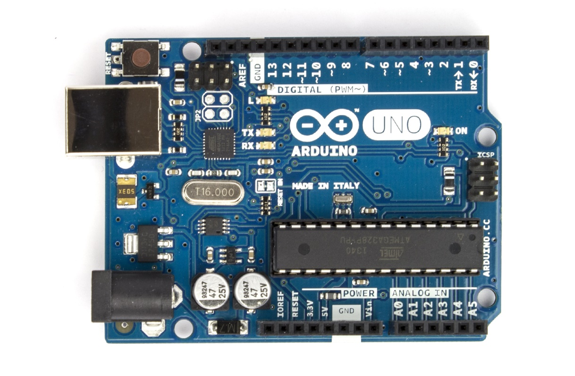

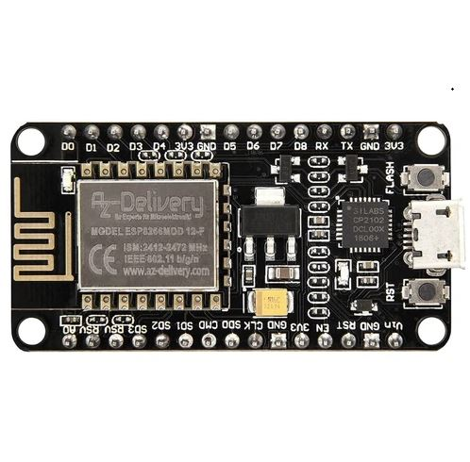



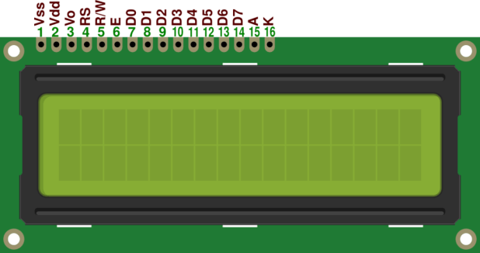
TOOLS AND COMPONENTS
ARDUINO UNO
RTC
NODE MCU ESP8266
LED, BUZZER, LCD
PROTEUS 8 PROFESSIONAL

Slide 9
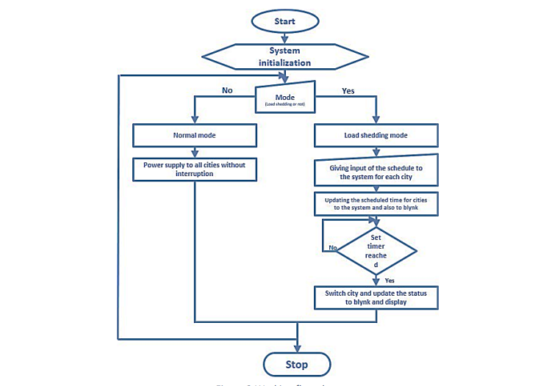
implementation
Normal mode
load shedding mode

Slide 10
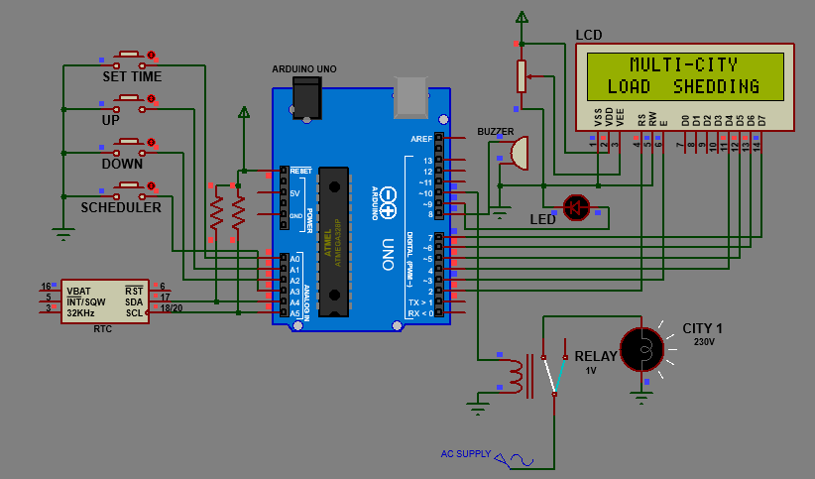

RESULT
1
2
Fig. Showing system initialization

Slide 11


result
1
2
Fig. Showing the setting of time after initialization.

Slide 12
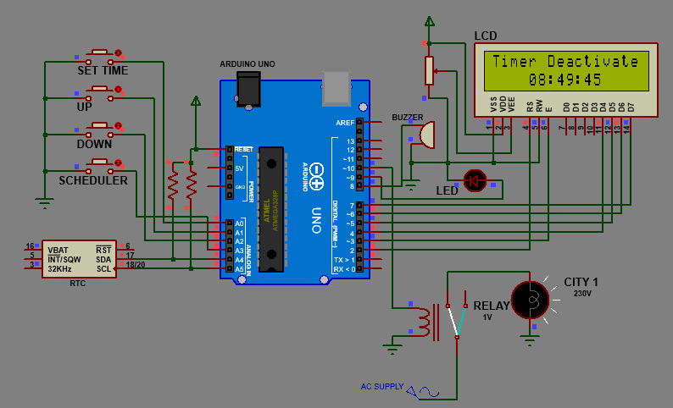
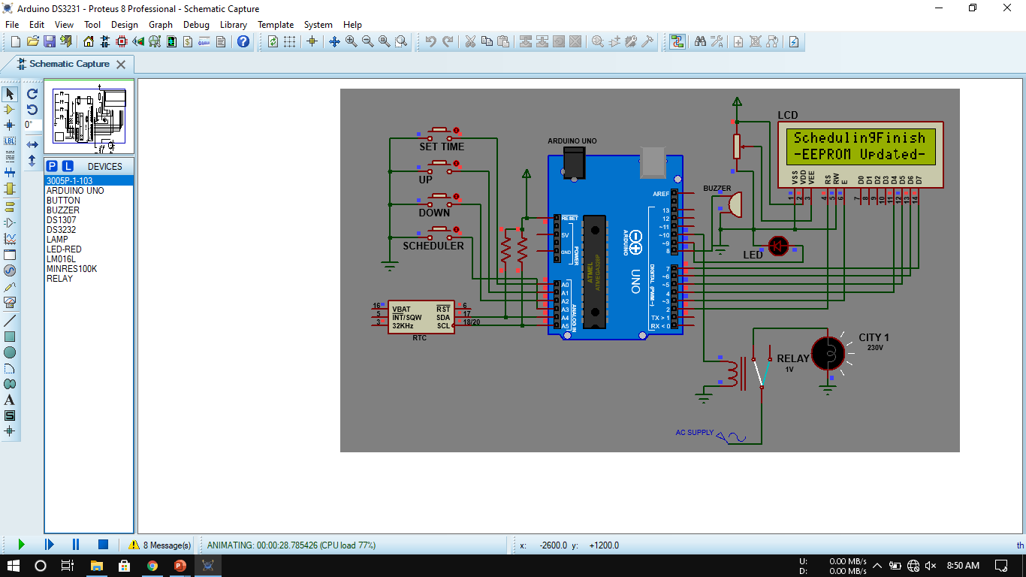

result
1
2
1
2
Fig. Showing the setting of schedule for a city.

Slide 13
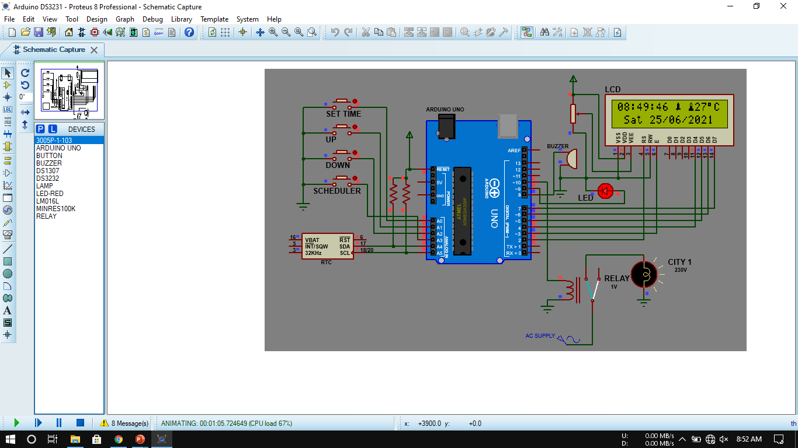
result
1
2
Fig. Final output during load shedding at the set schedule.

Slide 14
conclusion
Our project tried to address importance of load shedding and how it can be improvised through automation and IoT.
Tried to redefine the conventional load shedding methodology.
Transforming the energy sector from a central, hierarchical supply chain to a decentralized, smart and optimized system.

Slide 15
Advantages
The planned schedules .
Well informed schedules of the load shedding.
It reduces the humans risk.
Conserving time.

Slide 16
Future scope
The proposed project we brought forward can be further improved with the technological and network advancements.
Remotely controllable through blynk can be developed.
The same simulation technique will be implemented through hardware in PHASE-2.

Slide 17
references
[1] Ron Bartels,” using IoT at homes and industries to mitigate the effects of blackouts and to better resultant incidents of negative consequences”, Swinburne University of Technology.
[2] Raghu.C.N, G.Raghavendra, Doddabasappa N, Anil Kumar D B :”Situation Analysis of Load Shedding and its Effectiveness in the Area of Power System Security” in International Journal of Applied Engineering Research ISSN 0973-4562 Volume 13, Number 20(2018) pp. 14561-14565 , Research India Publication.
[3] Itika Sharma, Shavet Sharma : “Load Shedding Management” in International Journal of Trend in Scientific Research and Development (IJTSRD), ISSN: 2456-6470 .
[4] Praveen Raj R.S, Aditya Narayan, Akhil Joshy, Nandu Krishnan RB, Rahul S : ”IOT based Load Shedding” in International Journal of Science and Research (IJSR), ISSN:2319-7064, ResearchGate Impact Factor(2018): 0.28 | SJIF(2018): 7.426 .

Slide 18
THANK YOU

